Slide 1
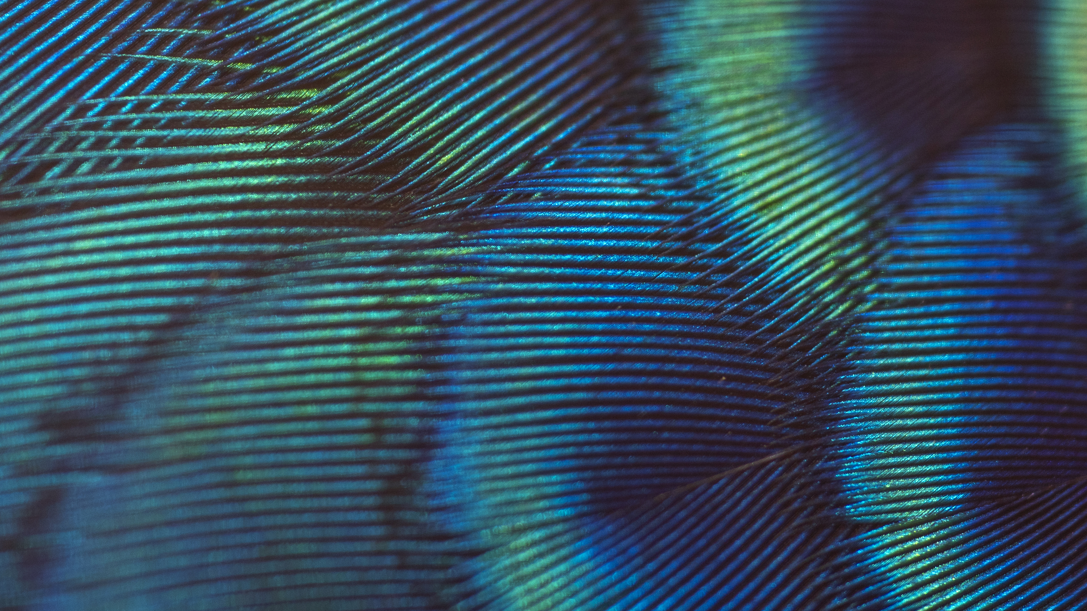
NEURAL NETWORKS
Nicholas Papano

Slide 2
Before we begin…
Make sure to pull the code now, the dataset is a bit large
The neuron images are from a book called Neural Networks from Scratch
If you want to do a deep dive with all the math, highly recommend ☺
DO NOT run the whole notebook. The outputs of some of the cells are intentionally left in there for you to look at
It’s unlikely we’ll get through everything today
Let me know if you can’t download python onto you own machine
Anyway, without further ado…

Slide 3
IT’S THE MOMENT YOU’VE ALL BEEN WAITING FOR

Slide 4
NEURAL NETWORKS!!!

Slide 5
Building Blocks: the Neuron

Slide 6
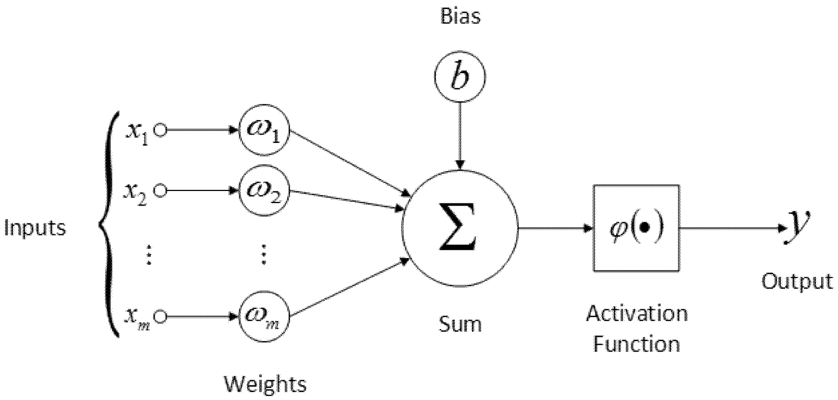
Neuron anatomy
Inputs: starting value(s)
Weights: adds an “importance” to each input
Bias: offsets data
Activation Function: function that modifies output
Output: final value

Slide 7
Do-nothing Neuron

Slide 8
Adding activation function and bias

Slide 9
Changing weight

Slide 10
Chaining them

Slide 11
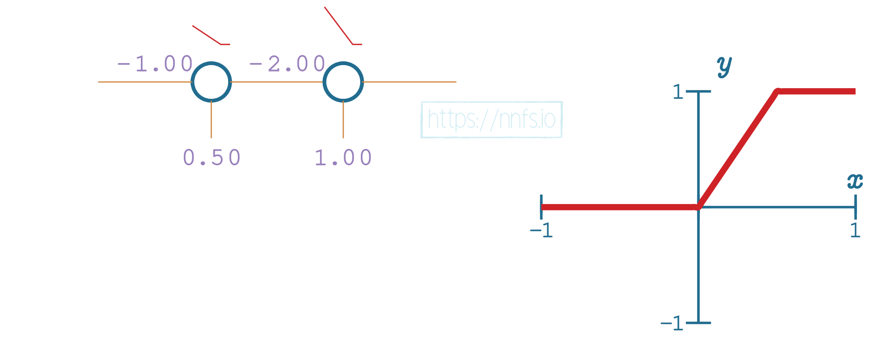
Chaining them (for real this time)

Slide 12
Crash Course: Neural Networks
With the mathy math removed!

Slide 13
Setting up a Network

Slide 14
Getting Interesting

Slide 15
Adding Connections and Optimizer

Slide 16
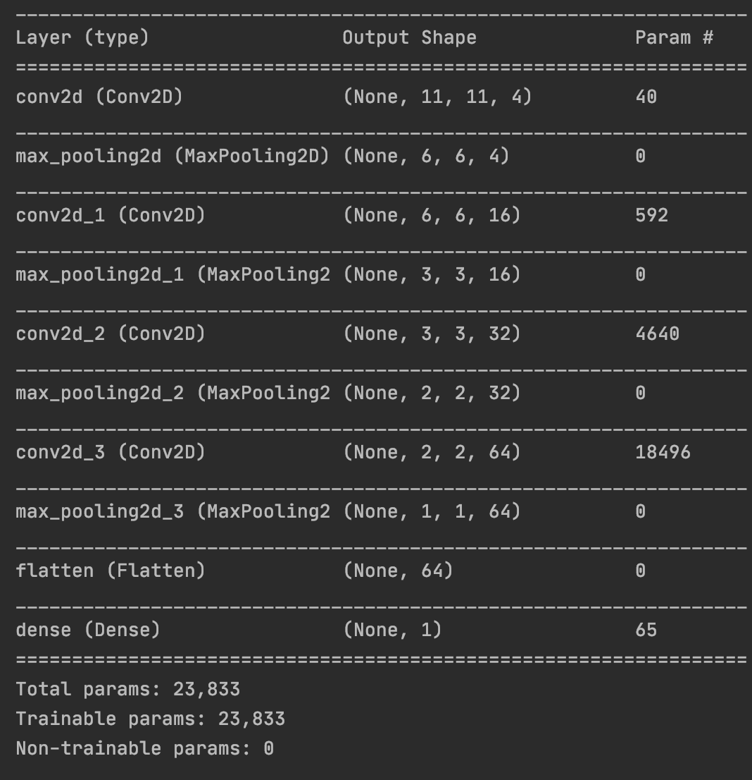
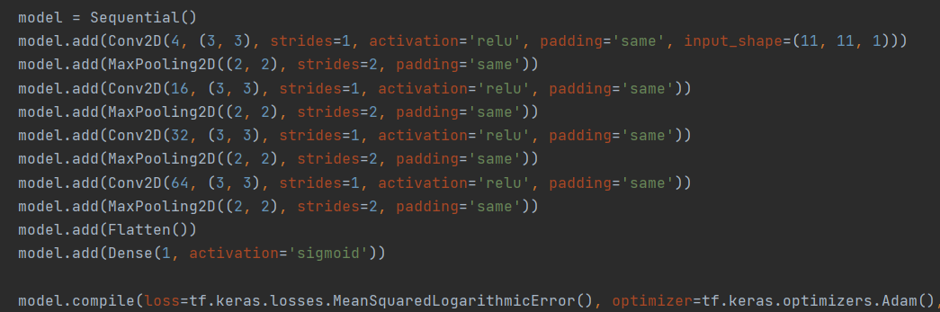
Convolutional Neural Network Example
Input: Hex Game board (11x11 grid)
Output: [0, 1] win % of the board (0 = black win, 1 = white win, 0.5 = tie)

Slide 17
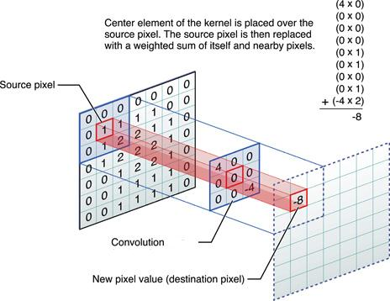
CNN Layer: Convolution (Conv2d)
Apply a sliding-window kernel
Then apply activation function
Padding controls the edge behavior
Stride controls the kernel movement

Slide 18

CNN Layer: Max Pool
Sliding-window like Conv2D
Select max value in window
Reduces size of matrix

Slide 19
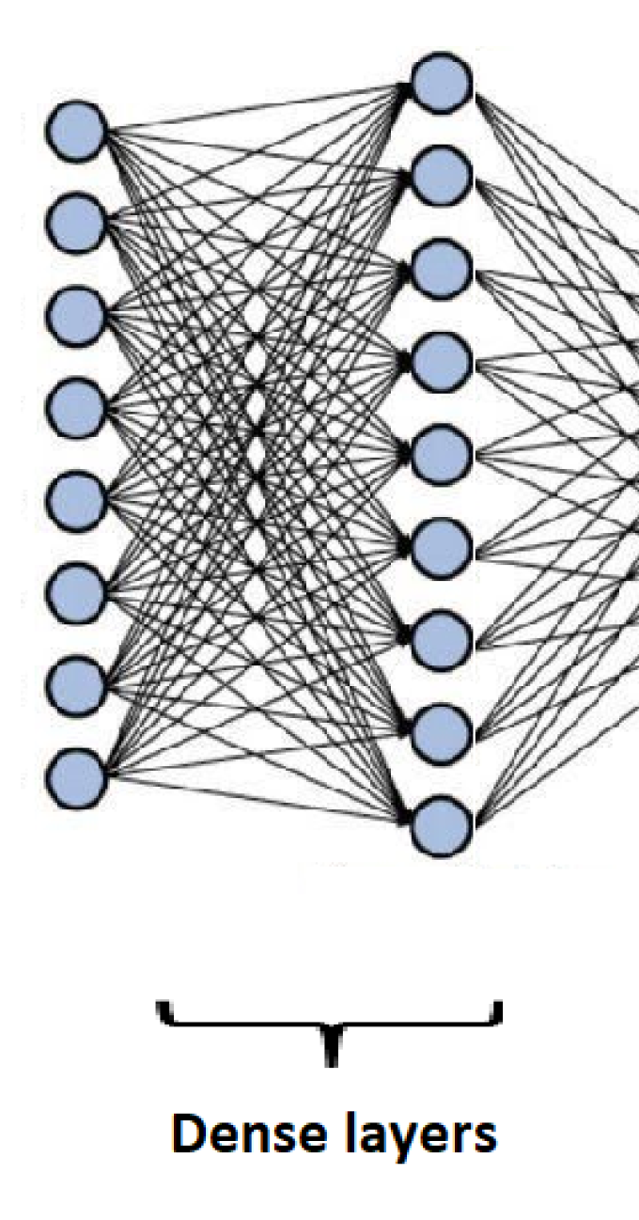
CNN Layer: Dense
Name comes from number of connections
Connects each input node to each output node

Slide 20

CNN Layer Honorable Mention: Flatten
“Layer” that helps simplify the matrix
Reshapes data so it is easier to work with
Takes input of 1x1x64 -> list of 64 values

Slide 21
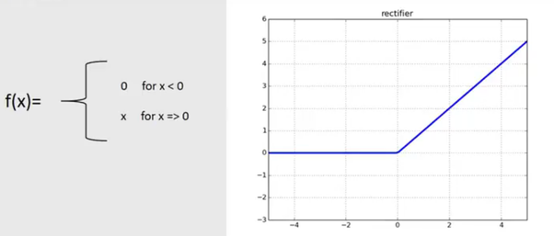
CNN info: ReLU Activation function
ReLU = Rectified Linear Unit
Non-linear activation function
Computationally trivial -> max(0, x)
Allows for backpropagation via Stochastic Gradient Descent

Slide 22
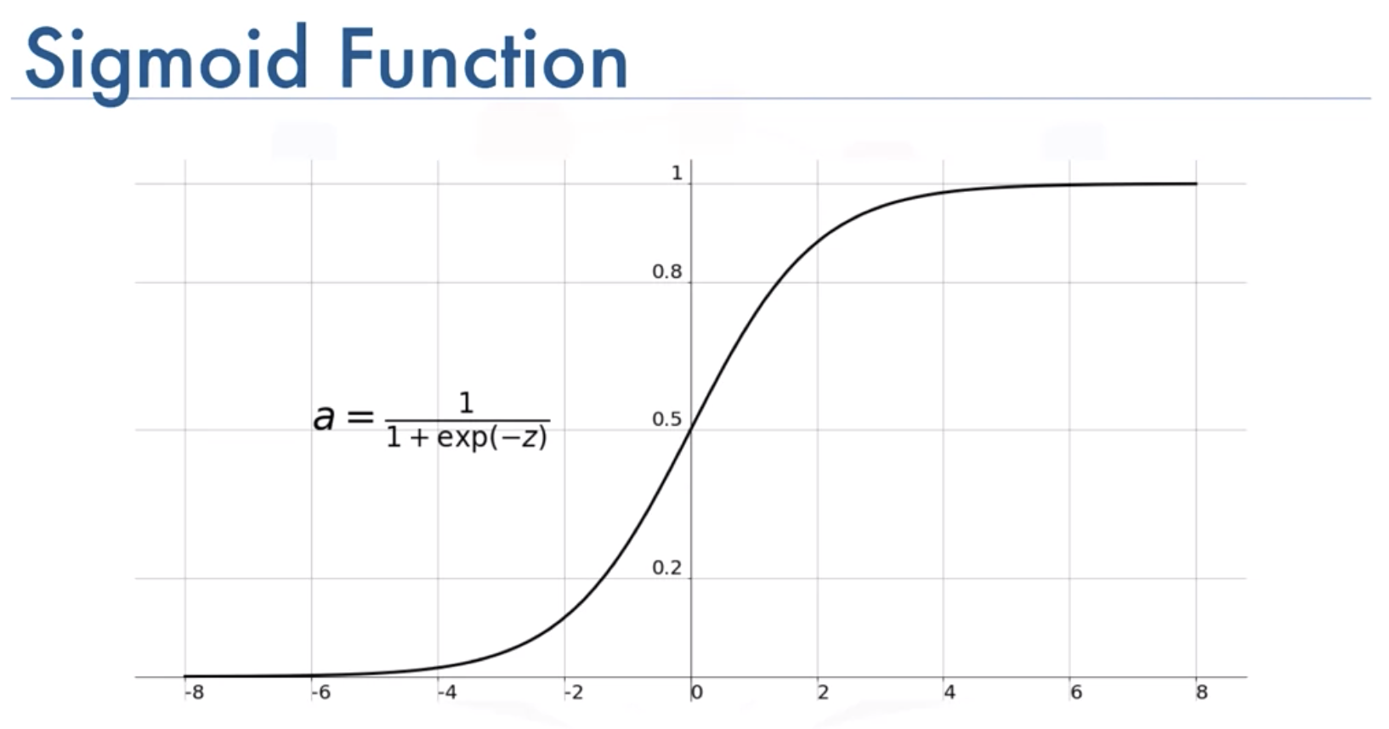
CNN info: Sigmoid Activation function
Sigmoid (Logistic function)
Normalizes data, output is [0,1]
“Vanishing Gradient” problem

Slide 23
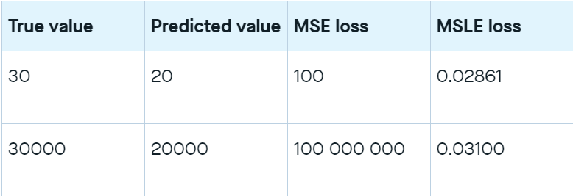
CNN info: Loss Function
Tells us how to measure how wrong the network is
Mean Squared Logarithmic Error (MSLE)
Like Mean Squared Error (MSE), but about percentage wrong
Average of difference between log(predicted) and log(actual)
Simplifies to average of log(actual/predicted)

Slide 24
CNN Info: Optimizer
Helps tell us how to update the weights so network improves
Well known one: Stochastic Gradient Descent (SGD)
Goal is minimizing loss, so find the deepest valley in the topology
Adam: adaptive moment estimation for gradient descent, uses momentum, averages of past gradients

Slide 25
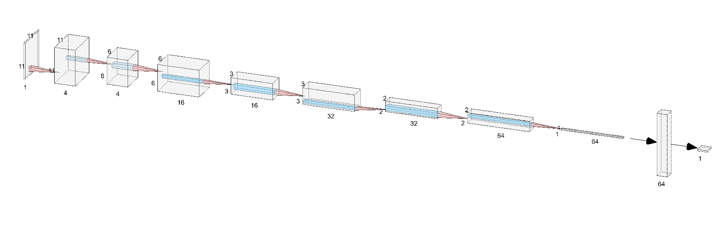
Architecture visualized
1. Conv
2. MaxPool
3. Conv
4. MaxPool
5. Conv
6. MaxPool
7. Conv
8. MaxPool
9. flatten
10. Dense

Slide 26
ARE WE GOING TO DO THIS?
No we aren’t!

Slide 27
Training a Neural Network for Vision

Slide 28

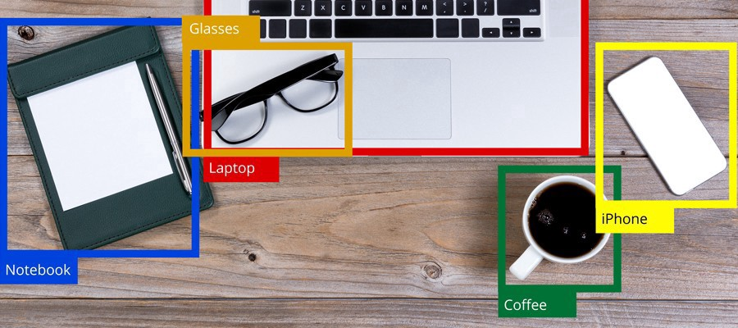
Bounding Box
Square around the object in the image
Comes with a label
Simpler version of image segmentation
We won’t cover this in depth

Slide 29
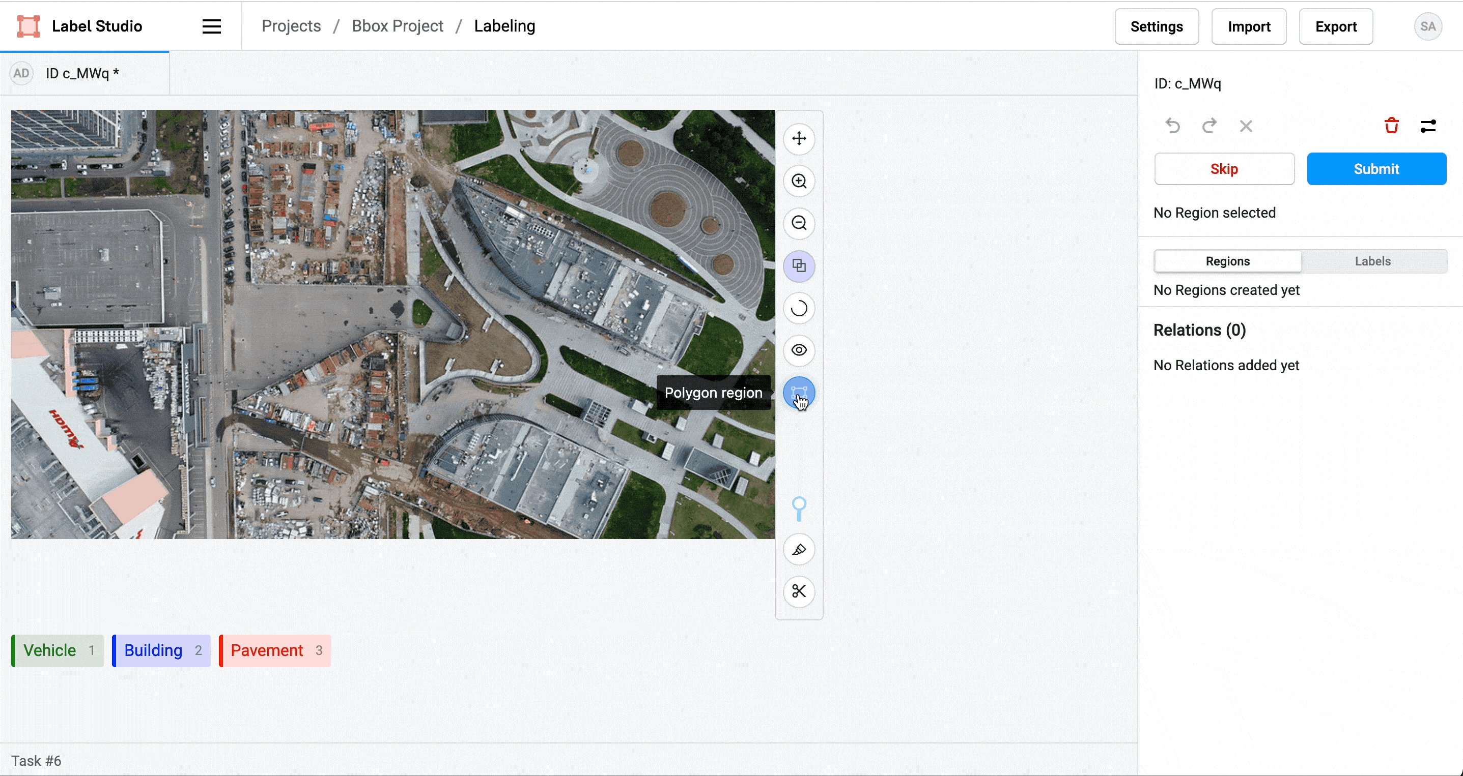
Labeling Data
What people spend a LOT of time doing
This will be a lot of the time spent when doing the robot

Slide 30
Measuring success

Slide 31
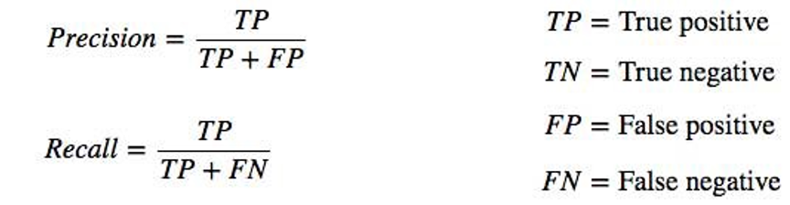
Precision and Recall
Precision: How accurate your predictions are
Recall: How good you are at finding the true positives

Slide 32
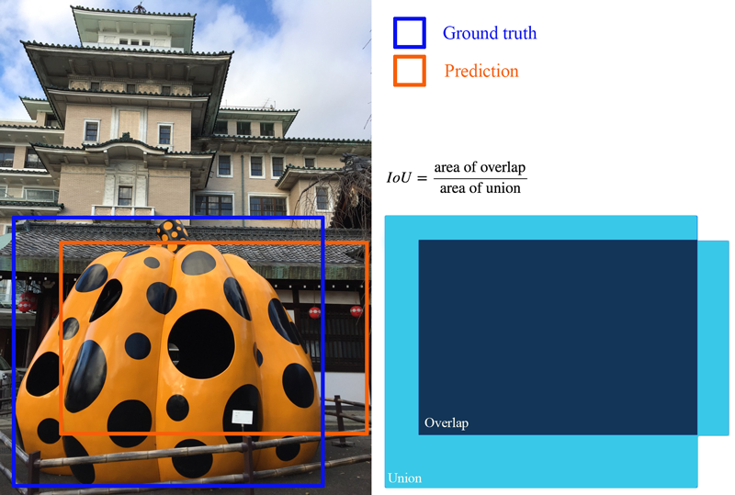
IoU (Intersection over union)
% of a prediction that is actually correct
Relies on QUALITY DATA
Ratio, so [0, 1]

Slide 33
mAP (mean average precision)
The mean area under the precision/recall curve across the various classes
Best to think of this as “overall accuracy”
You’ll want to investigate this more if you want to truly deep dive into computer vision

Slide 34
Transfer Learning

Slide 35
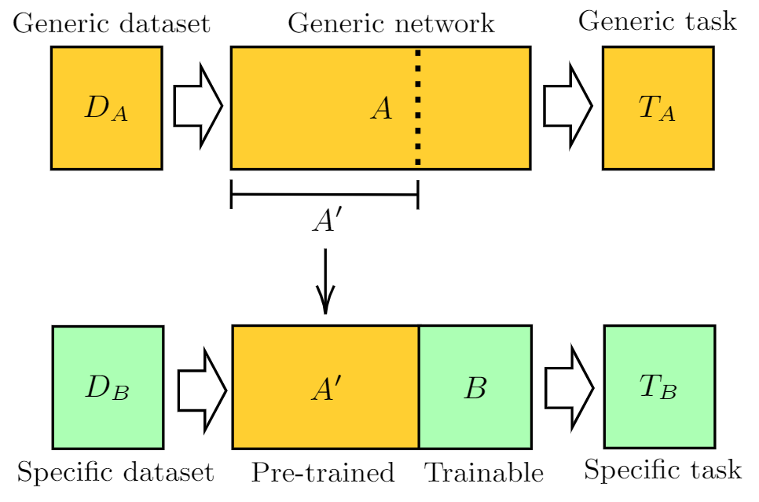
Transfer Learning
Lets us take a network already trained for a task and augment it with a new skill
Allows networks to learn much faster than from scratch
Trains a small part of the overall network

Slide 36
Transfer learning context
FIRST’s ML toolchain on their website uses Tensorflow’s Single-Shot Detection (SSD) mobilenet v2 320x320 trained on the COCO dataset
Take a look here: https://cocodataset.org/#explore
You provide labeled images to it
You hit the “train” button
You get 600 minutes of training

Slide 37
YOLO and Darknet

Slide 38
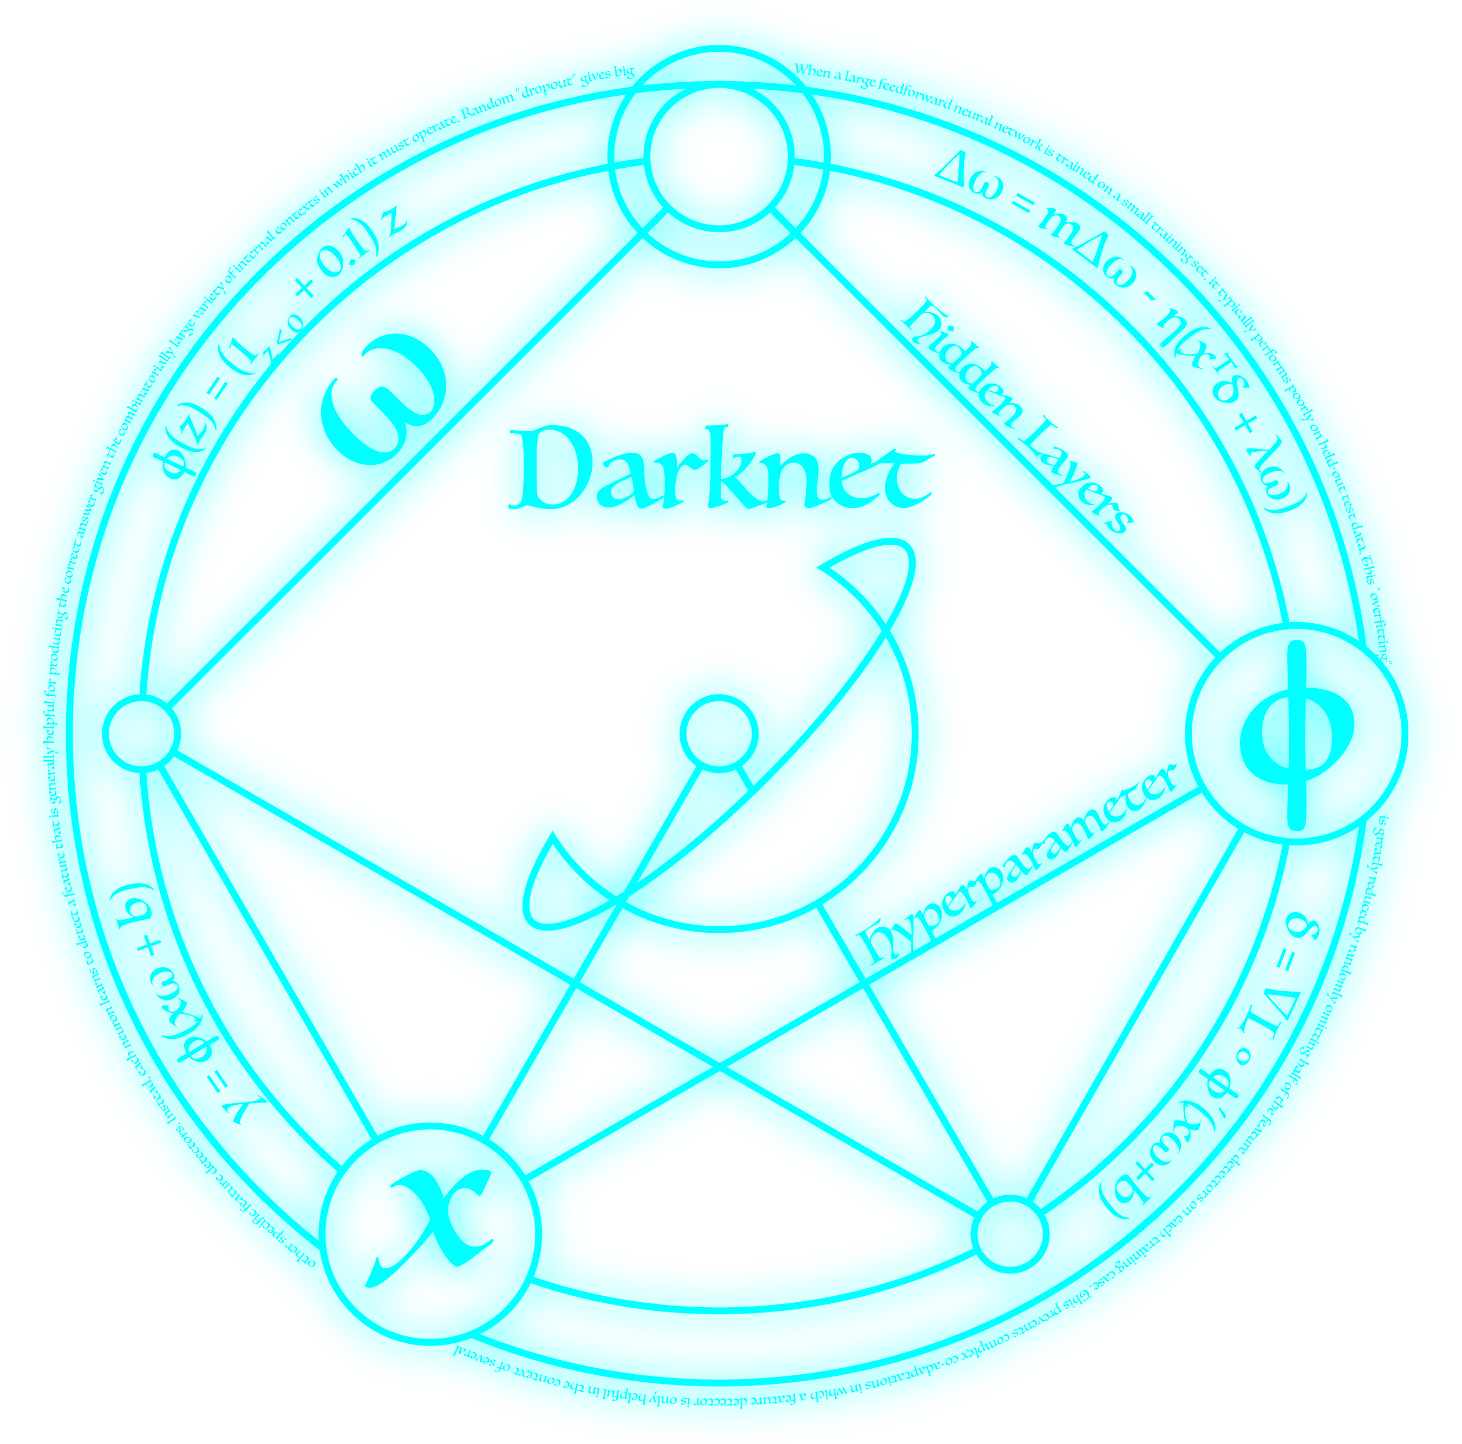
Darknet
Framework for neural networks
Imagine it’s kind of like tensorflow/pytorch but not quite
Supports GPU acceleration
From a University of Washington Grad Student
Author is a memelord
Do what you will with that information
Will NOT be going in depth into it

Slide 39
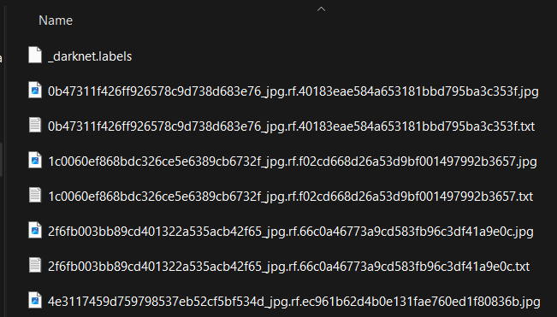
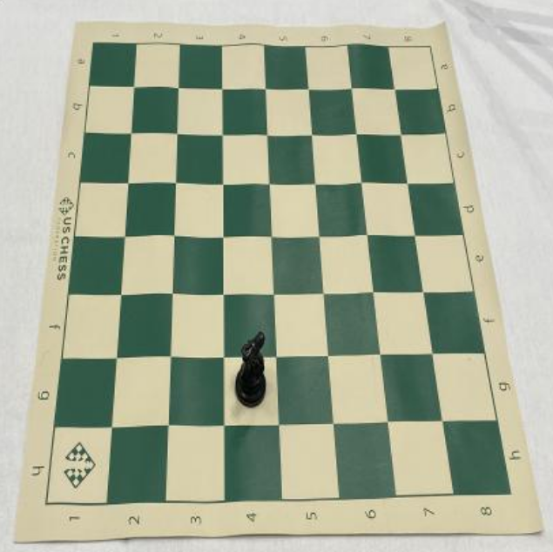
Darknet data format
3 folders: test, train, and valid (validation)
_darknet.labels file describing the label to integer mapping
Rows are 0 indexed
Each training item is comprised of a pair of files (with same name)
jpg image of the raw
Text file describing the labels
The text file has 5 numbers per row
First number is the class, next 4 describe the bounding box

Slide 40
YOLO

Slide 41
YOLO
Family of Neural Networks known for real-time processing
Name comes from its unique approach to analyzing an image
(Usually) Runs on Darknet
Pytorch/Tensorflow implementations exist
We’ll be using a small version (YOLOv4 tiny)

Slide 42
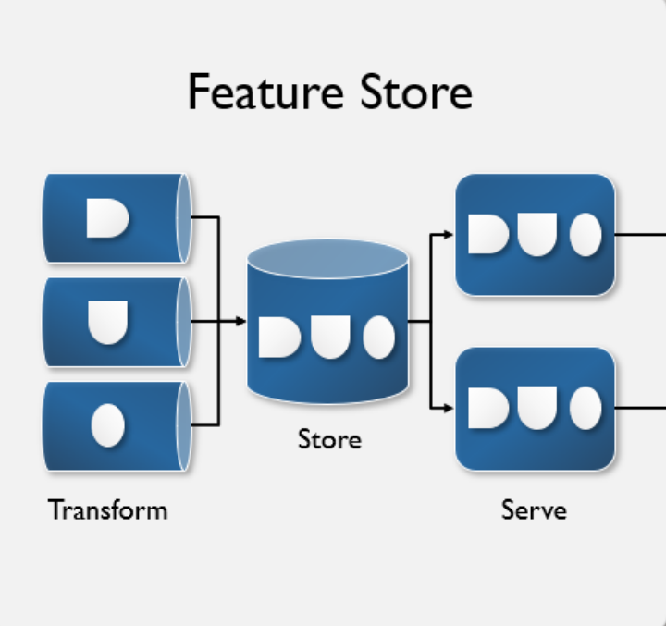
Aside: Feature Stores
In CV ML, stores images and labels
In large machine learning systems, this is a whole separate system from the model

Slide 43





Questions?

Slide 44
BEFORE JUMPING INTO THE CODE
Create a dataset and label a few images on a labeling tool. You can use either Roboflow or LabelStudio
Roboflow makes you make an account, whereas LabelStudio requires you to install Python onto your local machine
Understanding this labeling process CRITICAL to the success of the network

Slide 45
Otherwise, lab time!

